Slide 1

CGB1201 – JAVA PROGRAMMING
Department of Artificial Intelligence and Data Science Academic Year: 2024 – 2025 (Odd Semester)
Register Number Name
Year Semester Section Date
: 2303811724322107
: SRI HARITHA VARSINY R
: II
: III
: B
:03.12.2024
1
CGB1201 – JAVA PROGRAMMING

Slide 2
Title of the Project
EMPLOYEE PAYROLL MANAGEMENT SYSTEM

Slide 3
Problem Identification
🞂​ Ensuring the system calculates the salaries,deductions and
bonuses.
🞂​ Designing a user-friendly interface for both HR administrators
and employees to interact with the system.
🞂​ Protecting sensitive employee data (e.g., personal information, salary details) from unauthorized access.

Slide 4
Objective
🞂​ Design the system to handle a growing number of employees
and evolving payroll requirements.
🞂​ Provide reporting tools for payroll summaries and tax reports.
🞂​ Ensure secure access to protect sensitive payroll data, such as
employee salaries and personal information.

Slide 5
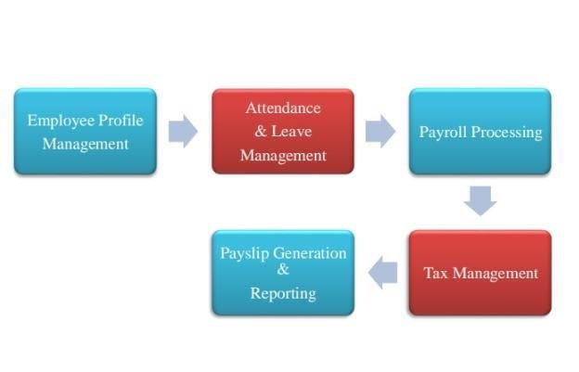
Proposed Architecture

Slide 6
Java Programming - Concepts Used
Classes and Objects:
Use classes to define the structure of an Employee, including attributes like name, salary, and deductions.
Exception Handling:
Handle errors in payroll calculation, such as invalid inputs (negative salary, incorrect tax rates).
File Handling:
Save and retrieve employee data (payroll records, tax information) .

Slide 7
Module Description
Employee Management Module:
The Employee Management Module focuses on managing employee- related data, such as personal information, job details.
This module serves as the backbone for processing payroll, tracking
employee activities.
Salary Calculation Module:
It is responsible for computing the salary of each employee .
This module ensures that the employee's salary is calculated accurately.

Slide 8
List of Modules
🞂​ Employee Management Module
🞂​ Salary Calculation Module
🞂​ Payroll processing module
🞂​ User Management Module

Slide 9
Module Description (Cont..)
Payroll Module:
Compute the salary for all employees based on hours worked and the hourly rate.
User Management Module :
The User Management Module is responsible for handling user accounts.
This is crucial for controlling who can access the payroll data .

Slide 10
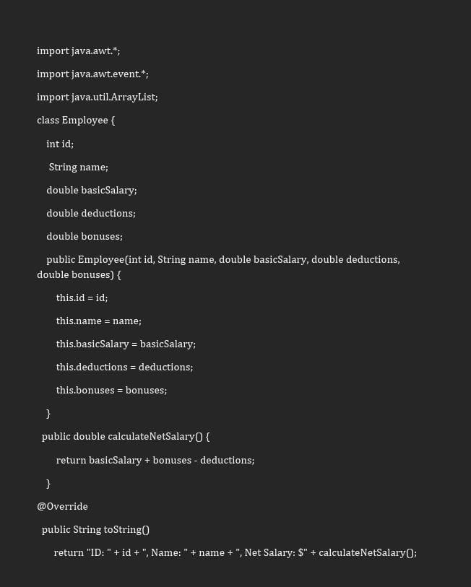
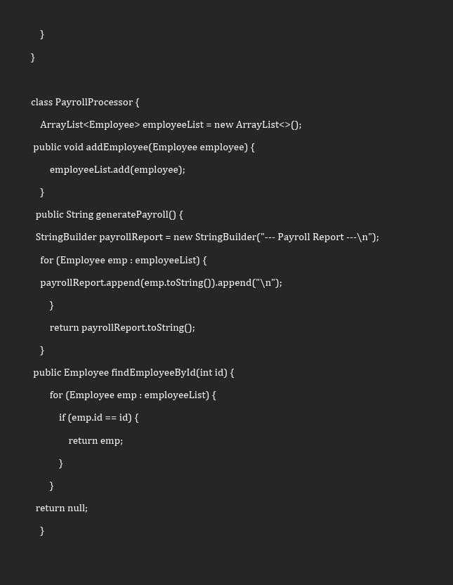
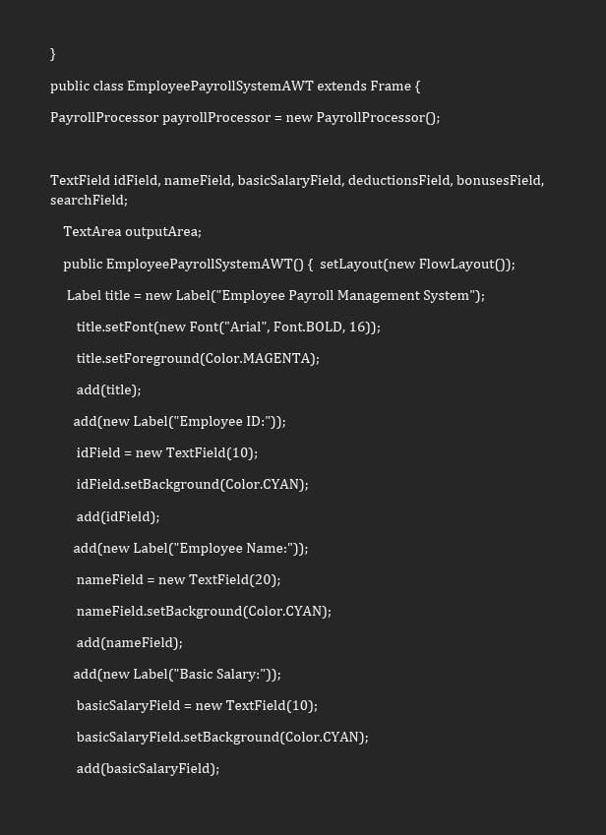
Source Code

Slide 11
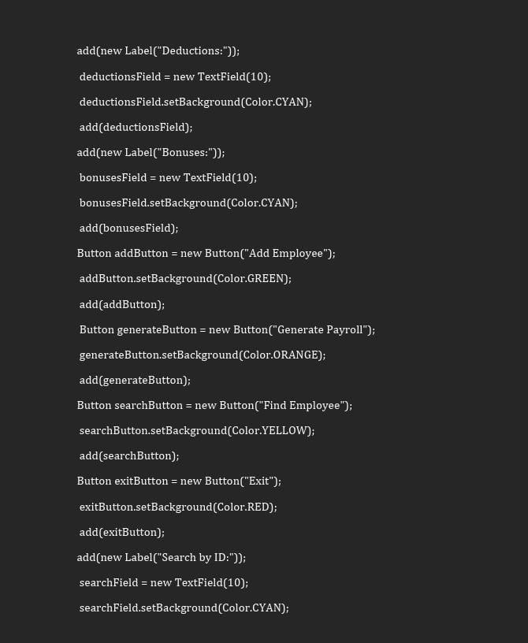
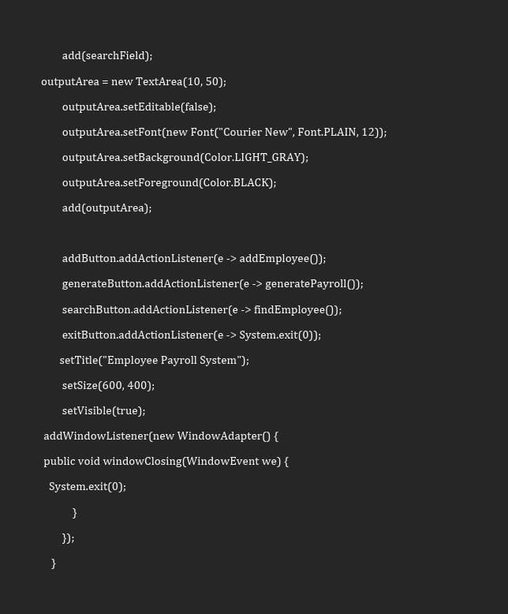
Source Code
11
EGB1201 – JAVA PROGRAMMING –
PROJECT REVIEW 2

Slide 12
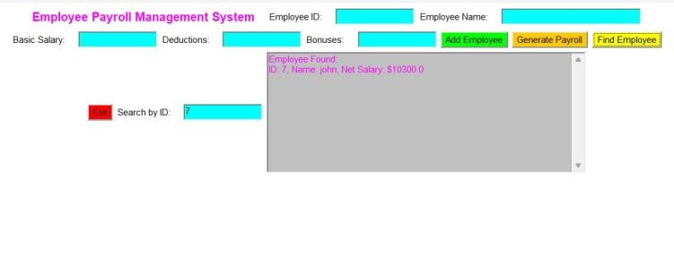
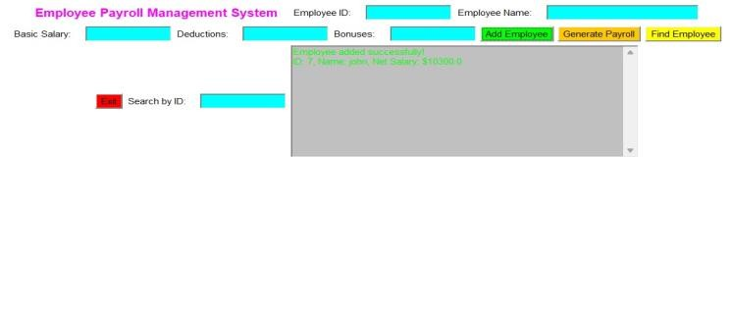
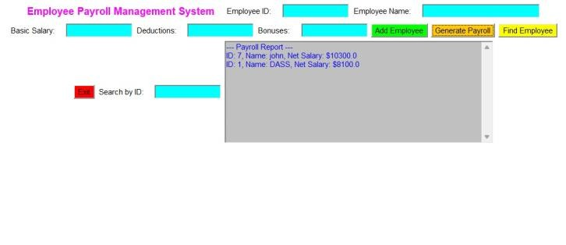
Results

Slide 13
Conclusion
🞂​ A Payroll Management System ensures employees are paid
accurately and on time.
🞂​ It helps the company stay compliant with laws and regulations.
🞂​ It keeps sensitive payroll data secure and reduces manual errors.

Slide 14
Thank You
ANY QUERIES???

